Slide 1
CNC Machine Finder
DATA PROJECT · WEB SCRAPING, SQL AND DASHBOARD
How a buyer can choose a CNC machine by budget and size, using 3,955 machine listings.
Data source: machinetoolindex.com
Notes:
Welcome. Our project answers one practical question: how does a buyer choose a CNC machine for a given budget and size? We collected the data ourselves, cleaned it, analysed it with SQL, and built a dashboard.

Slide 2
Comparing CNC machines takes too much work
1 · Scattered
2 · Messy
3 · Uncertain
Thousands of pages
Mixed units
Estimated prices
Every machine has its own page. There is no single table to compare them side by side.
Specs are text, such as 15 in (381 mm), 15 hp (11.2 kW) and 100 lb (45.4 kg).
95% of the prices we found are the website’s own estimates, not quotes.
CNC Machine Finder · Source: machinetoolindex.com
2
Notes:
A buyer must shortlist machines before asking suppliers for a quotation. Today that means opening many pages, converting units by hand, and trusting prices that are mostly estimates.

Slide 3
How can a buyer choose the most suitable CNC machine for a given budget and size?
THE BUSINESS QUESTION
Who needs it: workshop owners and purchasing engineers who shortlist machines before asking suppliers for quotes.
Also useful for: students and analysts who want to see how price relates to size, weight and power.
CNC Machine Finder · Source: machinetoolindex.com
3
Notes:
This is the question the whole project answers. Everything after this slide, the data, the SQL and the dashboard, exists to support a buyer who has a budget and a minimum machine size.

Slide 4
The data: 3,955 machines from one website
3,955
machines, each with its own specification page
6/19
website categories collected
219
manufacturers after merging spelling variants
1,564
machines with a price (39.5%)
Categories collected: CNC lathes, 5-axis machining centers, grinding, laser cutting, boring and gear cutting. Collected with Python, requests and BeautifulSoup.
CNC Machine Finder · Source: machinetoolindex.com
4
Notes:
We scraped the website page by page. The scraper saves after every machine, retries failed pages and logs failed URLs. We collected 6 of the website’s 19 categories, so our conclusions apply to those six.

Slide 5
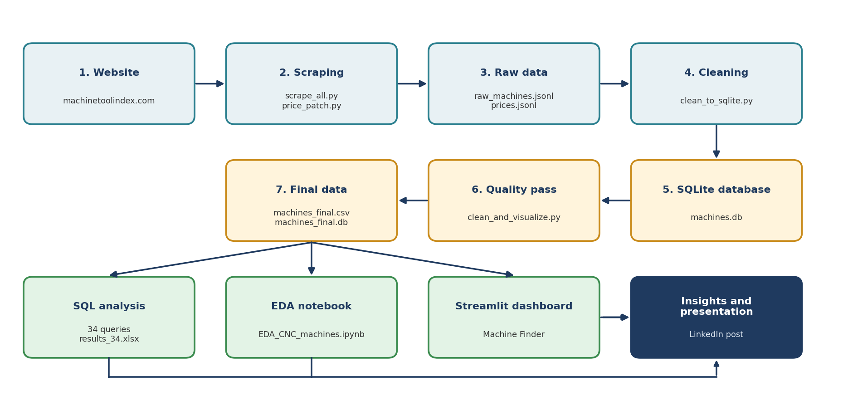
Workflow: from website to dashboard
CNC Machine Finder · Raw data is never edited, so the whole pipeline can be re-run
5
Notes:
Seven steps: scraping, cleaning, a quality pass, SQL analysis, an exploration notebook, the dashboard, and delivery. Every cleaning step starts from the raw file, so anyone can re-run the project from scratch.

Slide 6
Cleaning turned 5,213 raw columns into one table
What the raw data looked like | What we did
5,213 columns, most almost empty | Kept the key specs as clean columns (29 in the final table)
Text with mixed units, e.g. 15 hp (11.2 kW) | Converted to numbers in mm, kg, kW and rpm
Price text, e.g. Est. $200,000 - $275,000 | Split into low, high and midpoint, plus a price type: estimate or listed
226 spellings of manufacturer names | Merged into 219 names
Extreme values (26 prices, 17 X travel) | Flagged, not deleted. Missing values stay empty and are never guessed
CNC Machine Finder · Source: 03_cleaning/cleaning_report.csv
6
Notes:
Cleaning took most of the effort. The key rule: never guess. If a website page does not publish a value, the cell stays empty. Extreme machines are real, for example large gantry machines, so they are flagged and not removed.

Slide 7
34 SQL queries answer the buyer’s questions
QUERY 02
QUERY 07
QUERY 11
How many machines per category?
What can I get for under $500K?
How trustworthy are the prices?
Lathes lead with 1,673 machines, of which 694 have a price.
Example: Hurco VMX42Ui, a 5-axis center at $210K with 1,067 mm of X travel.
60.5% of machines have no price, 37.4% an estimate and only 2.1% a listed price.
All 34 queries are read-only SELECT statements. Their results are saved in results_34.xlsx.
CNC Machine Finder · Source: 05_sql/results_34.txt
7
Notes:
The SQL covers coverage, medians, price bands, manufacturer comparisons, data checks and the machine finder. Query 7 is the finder in SQL form: a budget plus minimum size gives a shortlist.

Slide 8
Machine type sets the price level
CNC Boring Machines
$950K
CNC Gear Cutting
$788K
5 Axis Machining Centers
$600K
CNC Laser Cutting
$550K
CNC Grinding Machines
$425K
CNC Lathes
$200K
Median price of the 1,564 machines with a price. A boring machine costs almost five times as much as a lathe at the median. Overall median: $375K. Mean: $647K, pulled up by a few very expensive machines.
CNC Machine Finder · Prices are mostly website estimates · Source: SQL query 03
8
Notes:
Category is the strongest driver of price. Lathes have the lowest median at 200 thousand dollars, boring machines the highest at 950 thousand. Remember that most of these prices are estimates from the website.

Slide 9
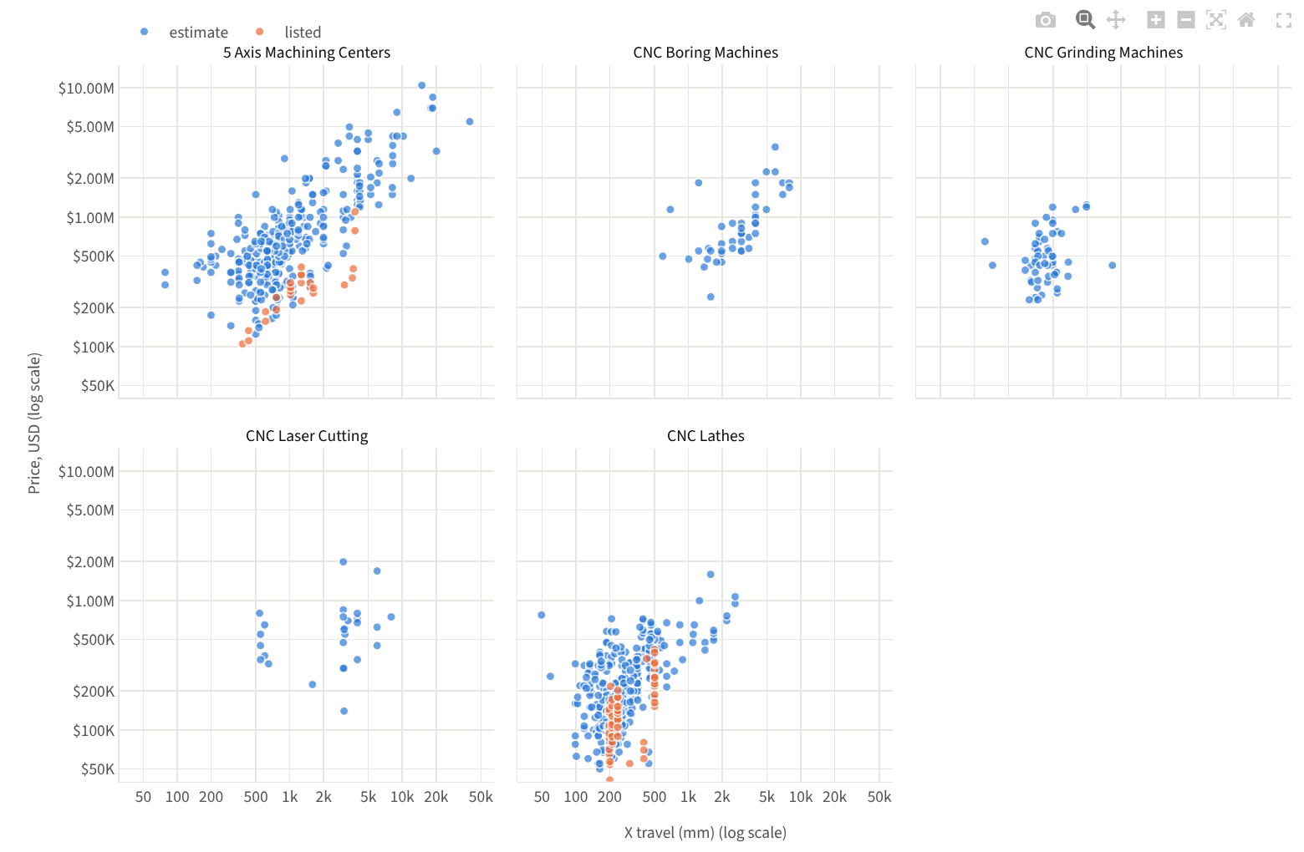
Size and weight track price, spindle speed does not
Rank correlation with price
X travel: 0.75
Machine weight: 0.74
Spindle power: 0.57
Max spindle speed: 0.34
1.0 means price rises in step with the measure.
CNC Machine Finder · Blue = estimated price, orange = listed price · Source: machines_final.csv
9
Notes:
Each dot is one machine, one panel per category, both axes on a log scale. Bigger travel and heavier machines cost more, with rank correlations of about 0.75 and 0.74. Spindle speed alone says little about price, at about 0.34.

Slide 10
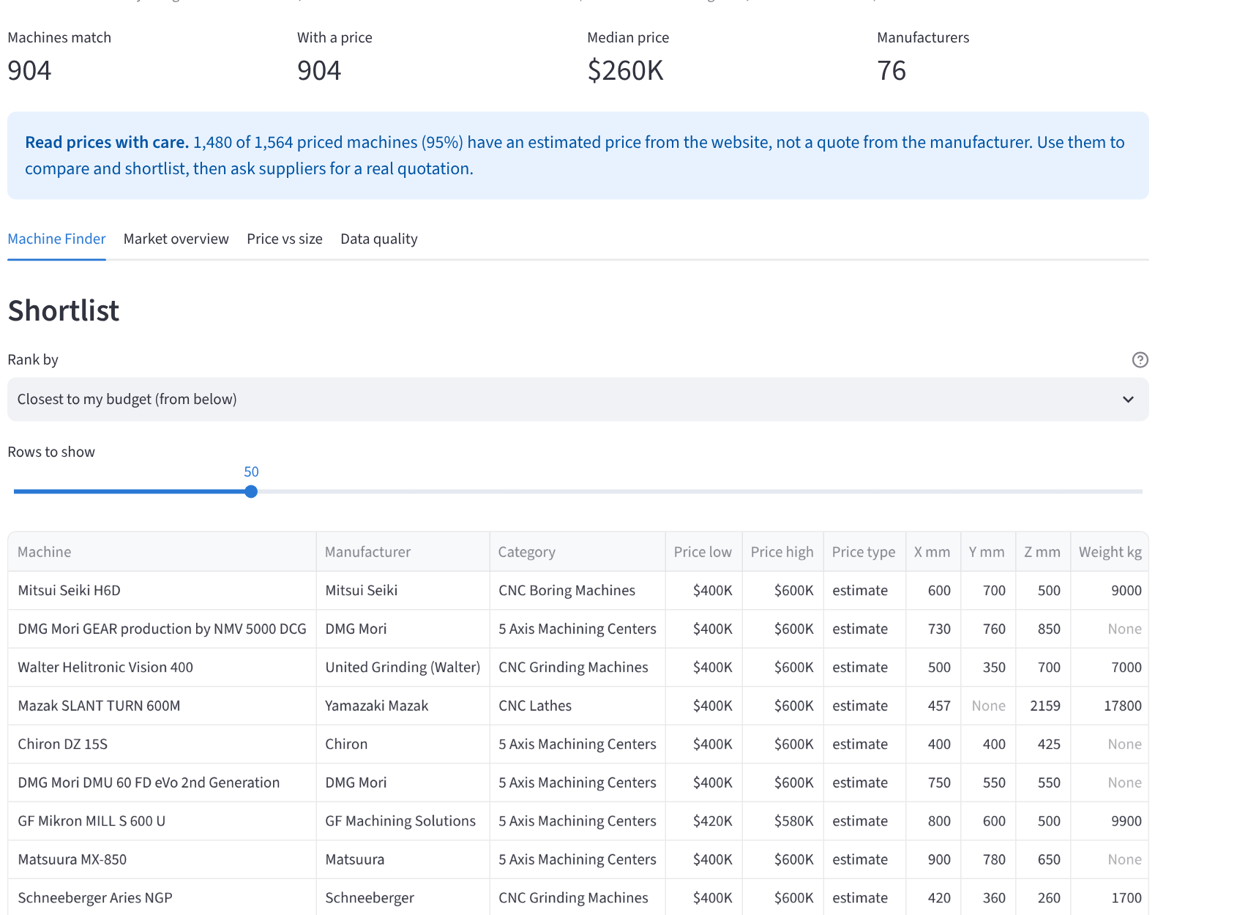
The dashboard: a shortlist by budget and size
Filter by category, manufacturer, budget and minimum travel.
Rank the shortlist, for example closest to your budget.
Compare prices by category and price against size.
Trust the result: every page says most prices are estimates.
Built with Streamlit on machines_final.csv.
CNC Machine Finder · Run: streamlit run 09_dashboard/app.py
10
Notes:
Live demo if possible. Example: budget 100 to 500 thousand dollars, rank by closest to budget. The table shows low and high price, travel in X, Y and Z, weight and a link to the source page.

Slide 11
Limits and next steps
Limits
Next steps
Only 6 of the website’s 19 categories were collected.
60% of machines have no price, and 95% of the prices that exist are estimates.
Specs the website does not publish stay empty, so size filters skip those machines.
Collect the remaining 13 categories, about 4,800 more machines.
Add a second price source, such as real quotes or used-machine sales.
Train a model that predicts price from category and size.
CNC Machine Finder · Source: 03_cleaning/cleaning_report.csv
11
Notes:
We state the limits openly. The conclusions apply to the six collected categories. Prices are website estimates, so the dashboard is for shortlisting and comparing, and a real quotation is still needed before buying.

Slide 12
Questions?
3,955 machines · 34 SQL queries · 1 dashboard that turns a budget into a shortlist.
Everything re-runs from the raw data: scraper, cleaning scripts, database, notebook and dashboard.
Notes:
Thank you. Happy to run the dashboard live or show the SQL queries and the notebook.

